Slide 1
West of Duddon Sands
Offshore Transmission
Investor Presentation | Period to 31 July 2025
Teams Conferencing Details
13.30 UK time 28 August 2025
Click here to join the meeting:
https://teams.microsoft.com/l/meetup-join/19%3ameeting_YWRlMjZhNzUtZTM3ZC00YWI5LWE5YzgtOThmYTc4ODY2MGVi%40thread.v2/0?context=%7b%22Tid%22%3a%22e6114f29-54a2-4064-85c5-a11219ebfbef%22%2c%22Oid%22%3a%22a67cd233-6f78-4ec2-be4d-06084e0cb1bf%22%7d
Meeting ID: 398 093 942 780
Password: Tn7E5mn2
United Kingdom, London (Toll):
+44 20 7660 8324
Phone Conference ID: 367 191 399#
Note: This Teams meeting is intended to be recorded and the audio recording will be published on the bondholders’ website.

Slide 2
Important Notice and Disclaimer
The information contained in this presentation is confidential and must not be disclosed to any other party.
The sole purpose of this information-only presentation (“Presentation”) is to provide information on a non-reliance basis about WoDS Transmission plc (“WoDS”) and the performance of the West of Duddon Sands offshore transmission assets. This Presentation should not be taken as an offer or invitation of any kind or a recommendation to buy, sell or hold the securities of WoDS or any other securities. Nothing in this Presentation constitutes or is intended to constitute an offer, invitation, recommendation or a commitment of any kind or a solicitation by WoDS, by Dalmore Infrastructure Investments 31 LP (“DII31”), by Dalmore Infrastructure Investments 32 LP (“DII32”), by Dalmore Infrastructure Investments 33 LP (“DII33”), by PPP Equity PIP Limited Partnership (“PIP”) or by Dalmore Capital Limited (“Dalmore”) as the manager of DII31, DII32 and DII33 (”DII Funds”) and PIP to provide services or to enter into any transaction (including but not limited to making an investment, underwriting or acquiring an interest in any securities or providing any financing in relation to WoDS, nor does it evidence an intention on the part of WoDS, the DII Funds, PIP, Dalmore or any of their affiliates or funds managed by them or their affiliates (together the “Companies”) to make such an offer. The Presentation does not and is not intended to give rise to legally binding relations and shall not create any legally binding obligations (whether contractual, non-contractual or otherwise) on the part of the Companies or any other person. ​
Nothing in this Presentation constitutes or is intended to constitute financial, legal, tax, investment, accounting or other advice and you should not act upon any information contained in the Presentation without first consulting a financial or other professional adviser. ​
No representation, warranty or undertaking is given by the Companies or by any other person in respect of the fairness, adequacy, accuracy or completeness of statements, information or opinions expressed in the Presentation and neither WoDS, the DII Funds, PIP, Dalmore nor any other person takes responsibility for the consequences of reliance upon any such statement, information or opinion in, or any omissions from, this Presentation. The information contained in this Presentation has not been audited or verified. The recipient should conduct its own independent investigation and assessment as to the validity of the information contained in this presentation, and the economic, financial, regulatory, legal, taxation, stamp duty and accounting implications of that information.​
The Presentation may contain forward-looking statements forecasts, estimates, projections and opinions, including certain statements about the future outlook for WoDS (“Forward Statements”). Any Forward Statements in this Presentation have been prepared by WoDS, WoDS’ service providers or Dalmore based on various assumptions concerning anticipated results (which assumptions may or may not prove to be correct) and are illustrative only. These are not guarantees of future performance and will not be updated. The actual results may be materially and adversely affected by economic or other circumstances and the analysis is based on certain assumptions with respect to significant factors that may prove not to be as assumed. Nothing contained herein shall constitute any representation or warranty as to future performance of WoDS securities, any financial instrument, credit, currency, rate or other market or economic measure and past performance is not necessarily indicative of future results. ​
To the fullest extent possible under English law, by accepting delivery of the Presentation, each recipient releases each of the Companies and each of their affiliates, advisers, directors, employees and agents in all circumstances from any liability whatsoever (other than fraud) howsoever arising from its use of the Presentation. In addition, no responsibility or liability or duty of care is or will be accepted by the Companies or their affiliates, advisers, directors, employees or agents for updating this Presentation (or any additional information), correcting any inaccuracies in it or providing any additional information to recipients. The recipient acknowledges that neither it nor any of the Companies intends that any of the Companies act or be responsible as a fiduciary to the recipient, its management, stockholders, creditors or any other person.​
The distribution of this Presentation in certain jurisdictions may be restricted by law. Persons into whose possession this Presentation comes are required to inform themselves about and to observe any such restrictions.​
This Presentation is not an offer of securities of WoDS or any WoDS entity for sale in the United States and securities may not be offered or sold in the United States absent registration under the U.S. Securities Act of 1933, as amended (the “Securities Act”), or an exemption from registration under the Securities Act. Any public offering of any such securities in the United States would be made by means of a prospectus that could be obtained from WoDS and which would contain detailed information about WoDS, its management and its financial statements. WoDS is not currently making any public offering in the United States and no such prospectus has been issued. No public offering of any such securities in the United States is currently contemplated.​
This document has not been approved by a person authorised under the Financial Services & Markets Act 2000 ("FSMA") for the purposes of section 21 FSMA. This document has not been approved by the UK Financial Conduct Authority, the Jersey Financial Services Commission or other relevant regulatory body, nor by a person authorised under the Financial Services & Markets Act 2000. This Presentation is only being distributed to and is only directed at investment professionals, as defined in article 19(5) of the Financial Services and Markets Act 2000 (Financial Promotion) Order 2005, who have professional experience in matters relating to investments. The transmission of this Presentation to any other person in the UK is unauthorised and may contravene FSMA and/or related regulations. No person within the UK who is not a person with professional experience in matters relating to investments as referred to above should treat this Presentation as constituting a promotion to him / her or to rely on it for any purposes whatsoever. ​
Dalmore is acting only for the DII Funds and PIP and is not acting for any other person (a "third party"). Dalmore will not be responsible to any third party for providing the protections afforded to clients of Dalmore and will not be advising any third party on investing in Dalmore managed funds, WoDS or any other investments of any kind.​
This disclaimer notice (and any non-contractual obligations arising out of or in connection with it) is governed by English law.​

Slide 3
 | Agenda & Welcome | 4-5
 | Background | 6
 | Transmission consortium | 7
 | Operational highlights | 8-10
 | Financial highlights | 11
 | Outlook | 12
 | Questions | 13
 | Appendix | 14

Slide 4
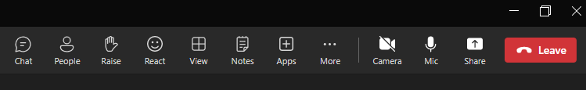
Agenda
  We propose to present the key aspects of the Investor Report and will be happy to take questions at the end;
  Please indicate if you wish to ask a question stating your name & organisation at the appropriate time.
  Please use the Teams application to indicate you have a question.

Slide 5
Welcome
  This is the annual investor presentation by WoDS Transmission plc to Bondholders
  The following representatives are present to answer questions:
    OFTO Director – George Tasker (Dalmore)
    OFTO Technical Director – Mike Edgar (Frontier Power)
    OFTO Director of Finance – Steve Noonan (Frontier Power)
    OFTO Financial Controller – Tim Price (Frontier Power)
    OFTO Finance Manager – George Stewart (IML)
  This presentation uses a number of acronyms or other abbreviations, and these are defined in an appendix to this slide deck.

Slide 6
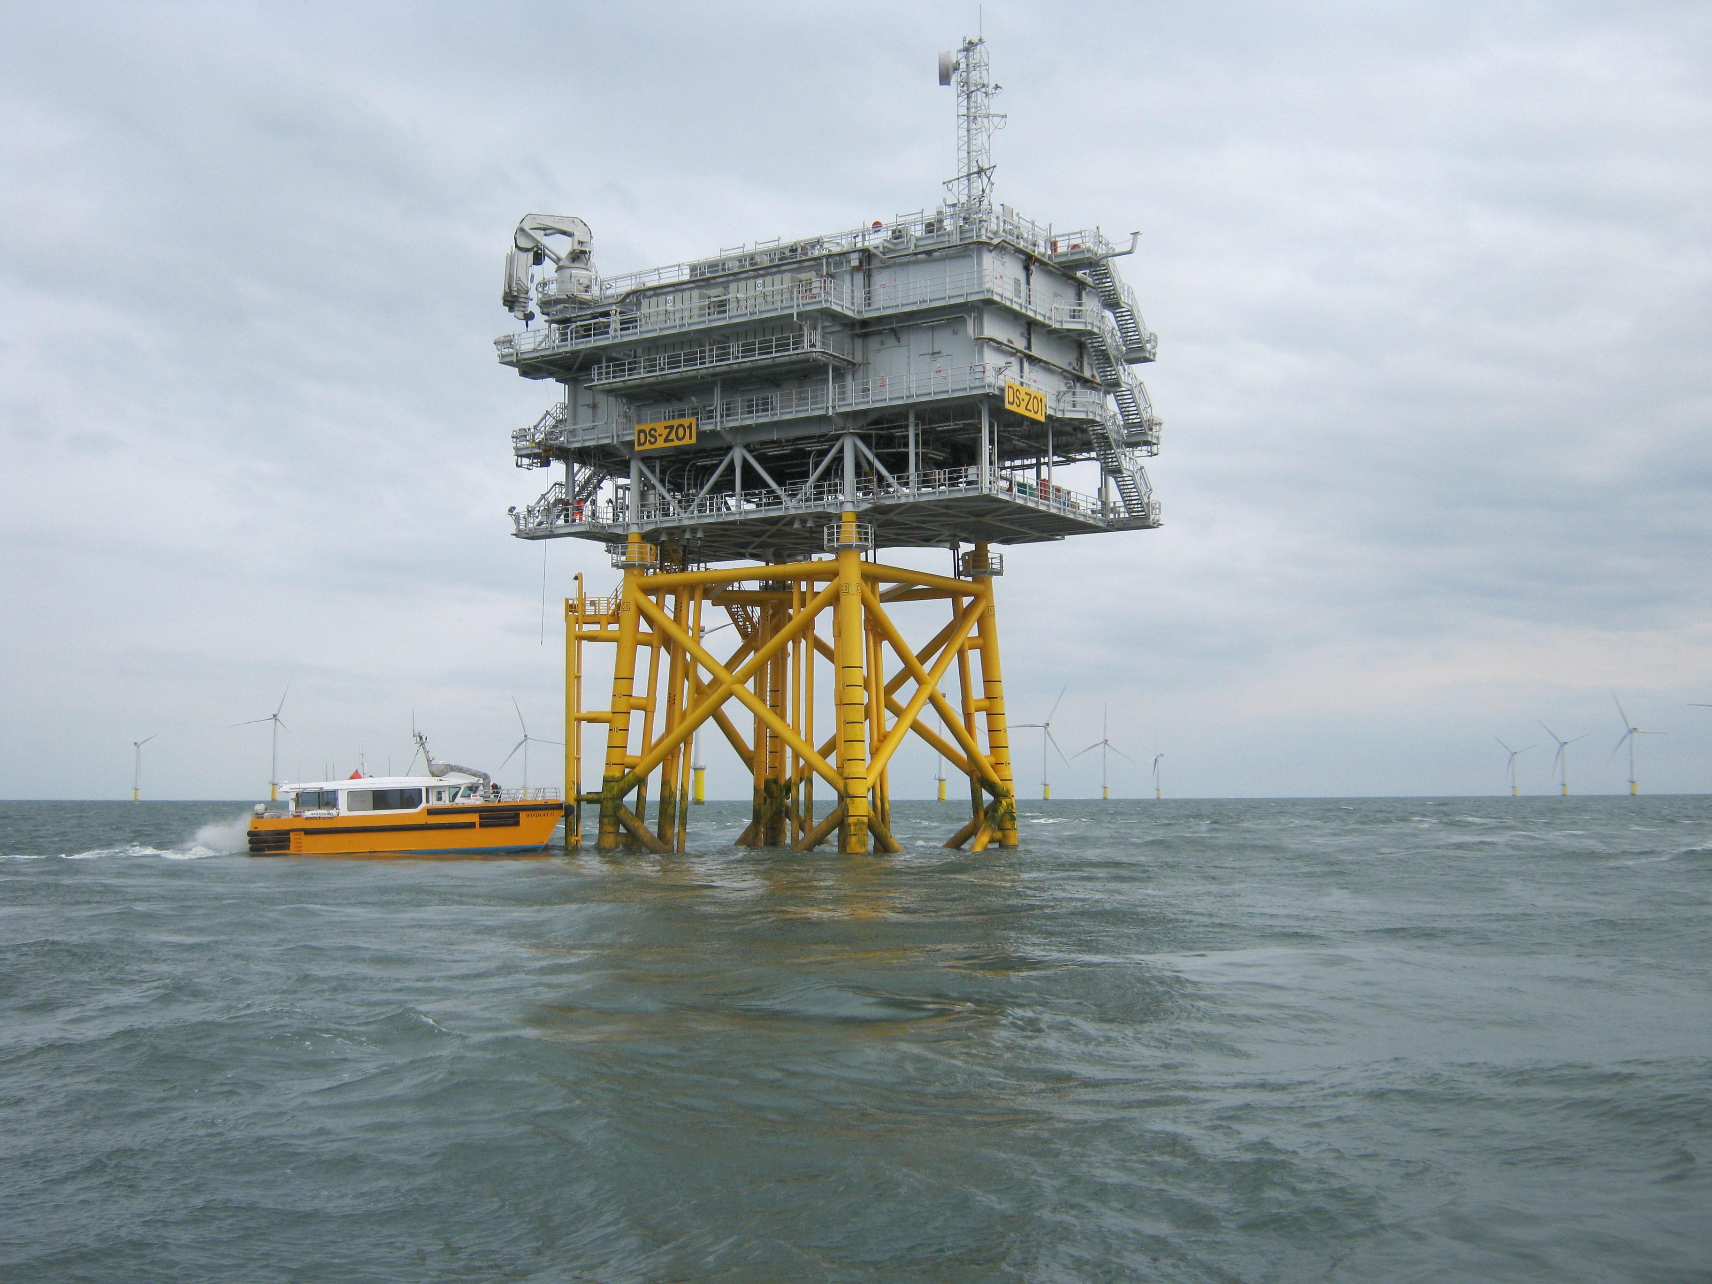
Background
  The generator owned West of Duddon Sands Offshore Wind Farm comprises 108 wind turbines with a total installed generation capacity of 389MW and ensures clean renewable energy for approximately 350,000 UK households.
  It is located in the Irish Sea, approximately 15km off Walney Island, Cumbria, UK.
  The WoDS transmission assets comprise the offshore substation, the transmission cables to the onshore substation, and the onshore substation with a Transmission Export Capacity (TEC) of 382MW.
  WoDS purchased the transmission assets on 25 August 2015 and operates the transmission assets under a perpetual licence granted by the Authority with a 20-year revenue entitlement period.
  WoDS is a special purpose entity that is ultimately owned by funds managed by Dalmore Capital Limited
  Frontier Power, an independent operator, asset manager and advisory business undertakes the role of Management Services Provider.

Slide 7



WoDS Transmission plc
Shareholders
  The equitable interest in WoDS Transmission plc is ultimately vested in the following funds: PPP Equity PIP LP, Dalmore Infrastructure Investments 31 LP; Dalmore Infrastructure Investments 32 LP and Dalmore Infrastructure Investments 33 LP
  These funds are managed by Dalmore Capital Limited - an independent fund management company that seeks to provide its institutional investors with access to long-term investment opportunities in limited volatility infrastructure assets
  As at 31 July 2025, Dalmore Capital had over £5.5+ billion of assets under management.
  On 22 May 2025, Dalmore Capital Limited, the asset manager of the funds invested in WoDS, announced that Royal London Asset Management had agreed to acquire the entire share capital of Dalmore Capital with completion expected later this year. This transaction is not expected to impact the day to day asset management operations of the WoDS OFTO.
Management Services Provider
Financial Services Provider
Frontier Power Limited
Infrastructure Managers Limited
Infrastructure Managers Limited (“IML”) provide financial and administrative services to WoDS Transmission plc.
IML was formed in 2005 and is a leading specialist provider of management services to the PFI/PPP market across a wide-ranging client base.
  Frontier Power Limited are engaged by WoDS Transmission plc to provide management services and report to the WoDS Transmission plc Directors. Frontier Power team members each have significant experience in developing and running utility sector businesses around the world.

Slide 8
Operational performance highlights - 1
Health, Safety & Environmental
  The O&M contractor continues to deliver HSE management for the offshore transmission assets owned by WoDS.
  HSE performance since asset transfer has been excellent with no reportable incidents.
  WoDS is managing and discharging its transferred obligations under the Marine Licence successfully.
Planned and unplanned Maintenance
  The majority of onshore and offshore planned maintenance and independent review of assets has been carried out to programme and completed successfully.
  Circuit 1: An unplanned outage occurred on 20 March 2025, circuit 1 tripped during the offline testing of one of the harmonic filters. The filter was restored to service at on 21 March 2025 with a total lost availability of approximately half of the transmission system for a duration of 20 hours and 22 minutes; and
  Circuit 1: • Between 5 May 2025 and 8 May 2025, a planned major maintenance outage of circuit 1 took place for the purposes of replacing a voltage transformer. As a consequence, there was a loss of availability of approximately half of the transmission system for a duration of 87 hours and 31 minutes.
  No further outages are planned for 2025 with Circuit 2 major maintenance scheduled for spring 2026.
  Forecast availability performance for the year ending 31 December 2025, calculated on the basis of that required when reporting to the Authority, reflecting actual availability performance through to 31 July 2025, is expected to be 99.54%.

Slide 9
Operational performance highlights - 2
Pre-emptive MMO Marine Licence
WoDS was granted a licence under Part 4 of the Marine and Coastal Access Act 2009 on 17 Sept 2018. This allows WoDS to undertake specified maintenance activities over the WoDS project lifetime without unnecessary delay and sets the conditions under which work can be undertaken and the actions required to notify stakeholders.
Bathymetric Survey
As noted in previous Investor Reports, the interpretative report that followed from the 2023 bathymetric survey of the two export cables connecting the WoDS offshore platform to the onshore substation reported no adverse findings. In line with the report recommendations, the next export cable survey will take place in 2026 in addition to a cable protection system rock stabilisation routine integrity inspection. We will be co-ordinating with the wind farm generator to combine activities to minimise costs.
Availability
  Cumulative reported availability through to 31 July 2025 since asset transfer has been 99.58%.
  Availability from 1 August 2024 (being the day immediately following the end of the availability period reported in the last Investor Presentation) to 31 July 2025 was 99.51%;
  Following notification from the Authority on 15th January 2025 that the outstanding exceptional event claim relating to July 2021 and September 2022 outages was successful:
    Performance year ended 31 December 2021: Amended from 99.38% to 99.94%
    Performance year ended 31 December 2022: Amended from 99.30% to 99.51%
Stakeholder Relationships
  Good relationships have been maintained with key counterparties including regulatory (NGET, NESO and the Authority), financial (security trustee) and the O&M Contractor.

Slide 10
Decommissioning
WoDS Decommissioning
The revised WoDS Decommissioning Programme that followed from the mid term review and associated suite of financial documents were submitted to DESNZ in April 2025. We have received an acknowledgement of safe receipt however no further correspondence has been received to date.
On the basis of the revised WoDS Decommissioning Programme submitted to DESNZ, we do not expect any material deviation from the decommissioning cost assumptions currently reflected in the December 2024 Forecast presented to Investors. Consequently, the decommissioning reserve at 31 December 2025 is expected to be consistent with the current Forecast, only adjusted as necessary for any inflationary changes.
Once the revised WoDS Decommissioning Programme has been agreed by DESNZ and a new Decommissioning Programme approved by the Secretary of State, any changes to the expected costs and reserving resulting from this revised Decommissioning Programme will be incorporated into a future Forecast.
Decommissioning Arrangements
The Energy Act 2004 Section 111 allows the Secretary of State for Energy Security and Net Zero to make regulations relating to the decommissioning of Offshore Renewable Energy Installations. Regulations may include, for example, prescribed standards for decommissioning and provision about the security that a person may be required to provide. The prescribed standards for decommissioning at WoDS commencement in 2015 were set out in the prevailing Guidance published in 2011. This has been replaced in 2019 and WoDS, along with other OFTOs, have made representations concerning the changes in Guidance.
On 24 November 2023 the ENA OFTO Forum issued a paper to Ofgem and DESNZ proposing a way forward such that Tender Round 1 to 6 OFTOs* were not financially impacted by any retrospective change by DESNZ.
On 12 June 2025, Michael Shanks, Minister for Energy, wrote to the ENA OFTO Forum and stated that “Given the particular circumstances for early OFTOs (specifically, those in OFGEM’s tender rounds 1-6 within DESNZ remit) it is the government’s view that partial decommissioning for these OFTOs is in principle likely to be acceptable”.
This is subject to further assessment for each individual project, once complete DESNZ will initiate the normal approval process.
      * Note WoDS is a Tender Round 2 OFTO

Slide 11
Financial performance highlights
Senior Debt Structure
  As at 30 June 2025 the company’s senior debt structure reflects the following :
    Senior bonds outstanding £156,889k due August 2034
    RPI Swaps for 75% of revenue
    PBCE Letter of Credit of 15% of bond principal
Key Ratios
As at 30 June 2024 | Ratio for Relevant Period/Date (excluding undrawn PBCE) | Lock-Up Ratio Level (excluding undrawn PBCE)
Projected DSCR: | 1.11x | 1.10x
Historic DSCR: | 1.45x | 1.10x
Debt Life Cover Ratio: | 1.38x | 1.15x
Commentary
  With effect from 1 October 2024 NESO was acquired by the Secretary of State for Energy Security and Net Zero from National Grid plc on behalf of the UK Government and consequently is now a publicly owned body with the objective of supporting the UK government’s energy policies.
  For the current financial year ending (2025/26), transmission revenue of £32,342k is being invoiced and continues to be settled by NESO in accordance with industry standard conditions.
  Operating costs to 30 June 2025 are lower than budget – however, most of the variance is due to a change in expectation of the timing of maintenance activities and it is likely that the underspend will be caught up in a later period.
  Payments to key contractors continue to be made in accordance with payment terms.
  Key financial deliverables have been met, including the filing of regulatory accounts for the year ended 31 March 2025 with the Authority.
  No Event of Default has occurred.
  Cumulative debt service for the period from financial close through to 30 June 2025 was £169,879k in line with the financial close and current operational model.
  PBCE remains undrawn. PBCE Letter of credit stands at £23,533k as at 30 June 2025.

Slide 12
Outlook
Key operational priorities for the next 12 months:
Maintain focus on health, safety and environment during this and future years operations;
Maintain high availability performance;
Continue to apply Good Industry Practice and maintain close working relationships with the O&M contractor;
WoDS has submitted a revised Decommissioning Programme to DESNZ having reached the mid-term point of the current revenue entitlement period as defined in the offshore electricity transmission licence issued to WoDS. Reserving for the decommissioning of the OFTO’s assets commenced on 20 August 2025 consistent with the current decommissioning plan. Reserving will be amended as appropriate when any revised decommissioning plan is agreed with DESNZ.
Plan for a maintenance outage for Circuit 2 in 2026;

Slide 13
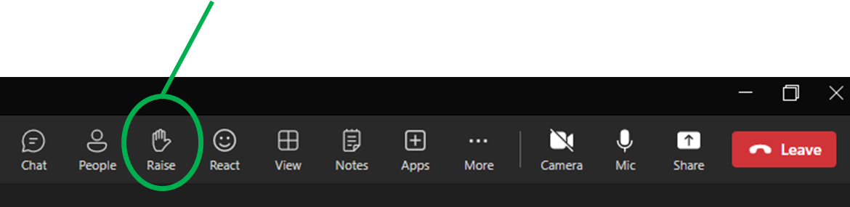
Questions ?
  Please use the Teams application to indicate you have a question.

Slide 14
Appendix
Acronyms and other definitions used in this presentation
    “the Authority” – the Gas and Electricity Markets Authority;
    “DESNZ” – Department of Energy Security and Net Zero;
    “DECC” – Department of Energy and Climate Change
    “DSCR” – Debt Service Cover Ratio;
    “ENA OFTO Forum” – An Energy Network Association forum representing OFTOs on technical and Regulatory matters;
    “Exceptional Event” – as defined in the offshore electricity transmission licence issued to WoDS;
    “HSE” – Health, Safety and Environmental;
    “MW” / “MWh” – Megawatt / Megawatt hours;
    “NESO” – National Energy System Operator Limited;
    “NGET” – National Grid Electricity Transmission plc;
    “OFGEM” the Office of Gas and Electricity Markets
    “OFTO” – Offshore Electricity Transmission Owner;
    “Ørsted” or “generator” – Ørsted West of Duddon Sands (UK) Limited being one of the joint owners and operators of the West of Duddon Sands wind farm;
    “O&M” – Operations and maintenance;
    “O&M contractor” – Ørsted West of Duddon Sands (UK) Limited and Scottish Power Renewables (WODS) Limited;
    “PBCE” – Public Bond Credit Enhancement provided by the European Investment Bank;
    “RPI” – Retail Prices Index;
    “TRS” – Tender Revenue Stream
    “WoDS” – WoDS Transmission plc.

